Slide 1
JavaScript Event Listeners

Slide 2
Introduction
An event listener in JavaScript is a way that you can wait for user interaction like a click or keypress and then run some code whenever that action happens. One common use case for event listeners is listening for click events on a button
element.addEventListener(event, function, useCapture);
The first parameter is the type of the event (like "click" or "mousedown" or any other HTML DOM Event.)
The second parameter is the function we want to call when the event occurs.
The third parameter is a boolean value specifying whether to use event bubbling or event capturing. This parameter is optional.

Slide 3
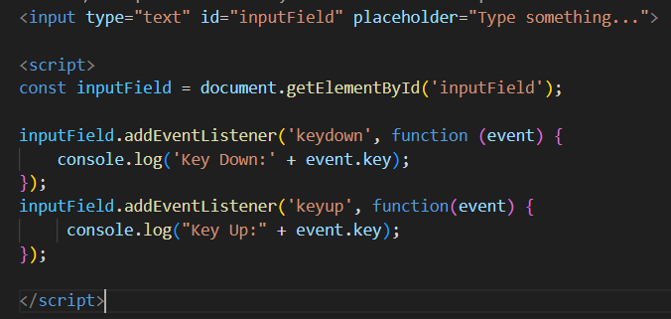
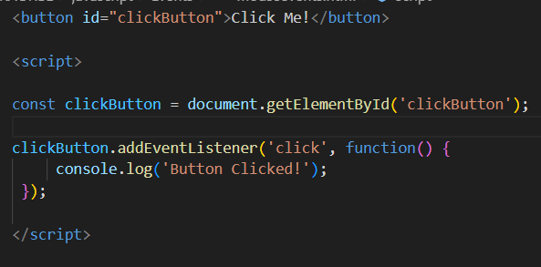

Slide 4
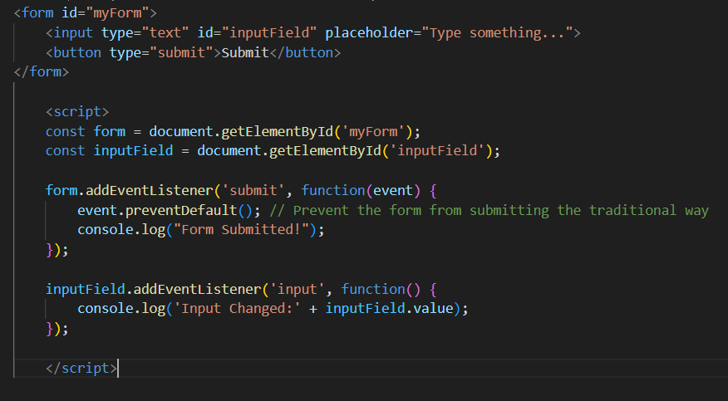

Slide 5
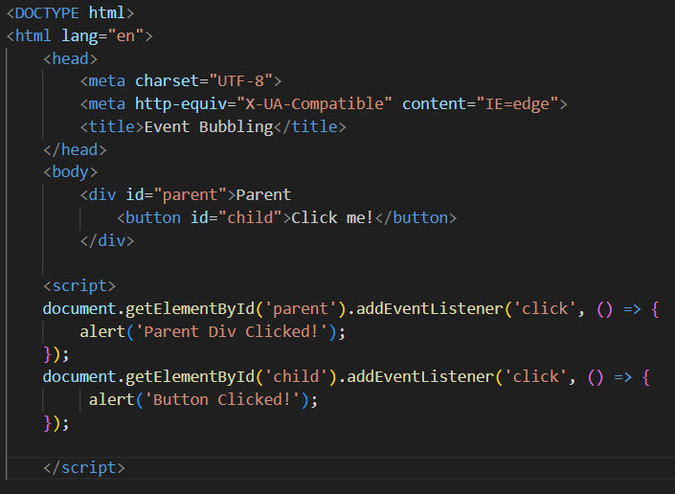
Bubble Phase
When an event is triggered on an element it will bubble that event up the document tree to all the elements the element is inside of.

Slide 6
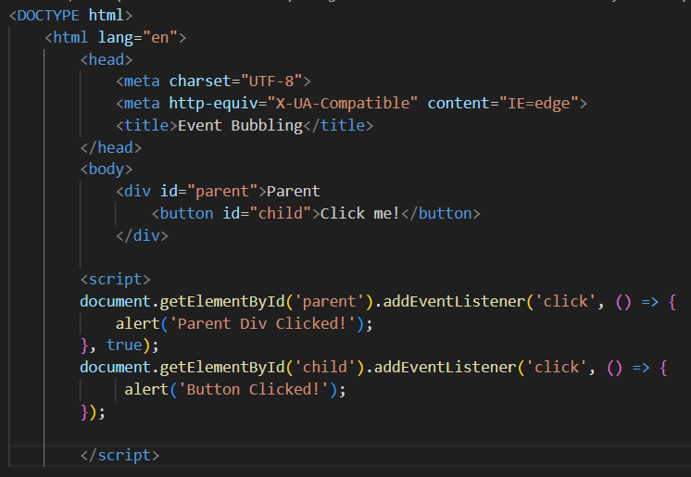
Capture Phase
The capture phase is just like the bubble phase but the event starts at the top level element, in our case the document, and works its way inward.

Slide 7
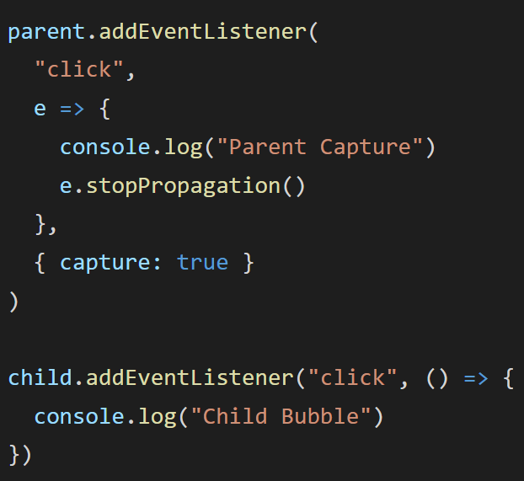
Stopping Event Propagation
By using the stopPropagation method on the event object we are able to stop the event from continuing its capturing and bubbling which means if there are any other event listeners in the chain that would fire they do not.

Slide 8
THANK YOU！

